Slide 1

Computer Systems Fundamentals
H175 34
Lecture 4
Text and Graphics

Slide 2


Up until now, we have been looking at how computers store integer numbers.
But they also store letters, other characters and punctuation marks. Most systems use at least…
10 Numerics (0 to 9)
26 Alphabetics (A to Z)
16 Special Characters (£, &, = etc.)
But how can text be stored using just 1s and 0s?

Slide 3
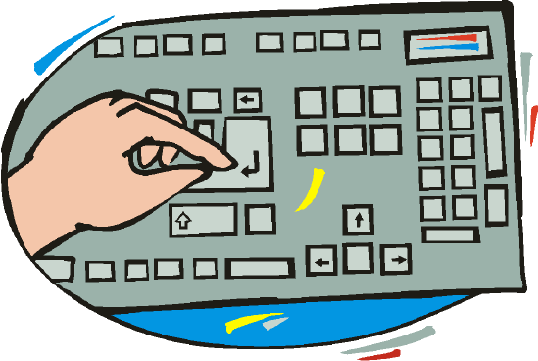
The most basic format is to use 7 bits to represent each number or character. Other functions such as enter and delete have to be represented as well!
All the individual letters, numbers and symbols normally found on a standard 104-key keyboard somehow have to be stored in binary.

Slide 4
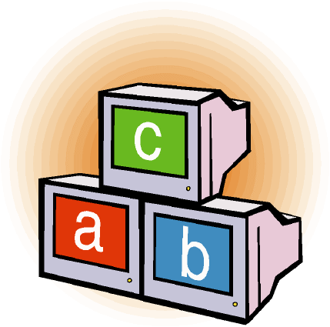
The particular range of characters any system uses is known as its character set.
Each character is assigned a unique binary pattern so that it can be stored and manipulated within the computer.
There are a number of different standards showing which binary pattern represents each character, but the most commonly used character set is ASCII (American Standard Code for Information Interchange).

Slide 5
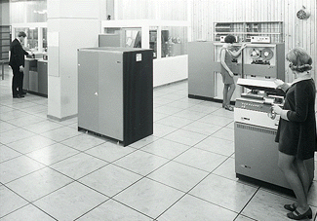
Older mainframe computers often used a different system called EBCDIC (Extended Binary-Coded Decimal Interchange Code ). This code was introduced by IBM for its early computers, but was not adopted by other computer manufacturers.

Slide 6
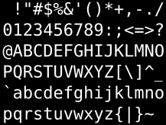
Basic ASCII is also known as the ISO-7 character code, (International Standards Organisation) because the basic set only uses 7 bits.
This gives us a maximum of 2⁷, i.e. 128, different characters.
96 are the usual alphabet, punctuation symbols and numbers.
The other 32 characters are non-printing - things like the carriage return, backspace and bell (which nowadays beeps instead of rings!)

Slide 7
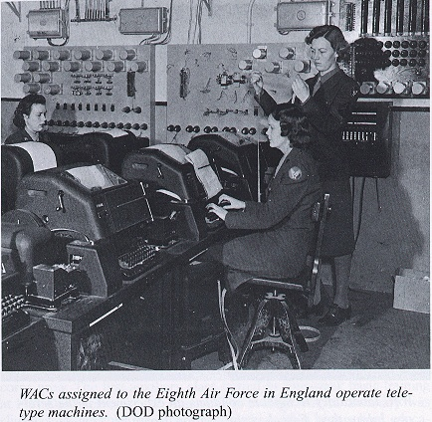
The Origins of ASCII
ASCII code originally came from the layout of Teletype machines. These obsolete electro-mechanical typewriters were used to communicate typed messages from point to point through a simple electrical communications channel - often just a pair of wires.

Slide 8
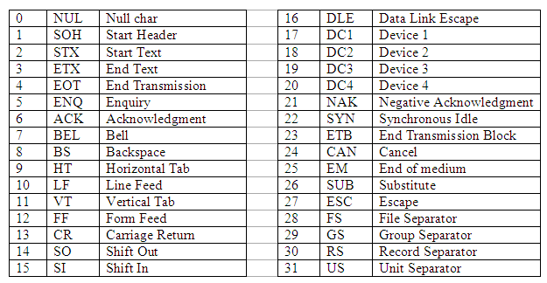
The Origins of ASCII
The first thirty-two characters show the legacy of mechanical typewriters and tape storage!

Slide 9

So how does the computer know whether it’s dealing with an integer number, or a text character?
Is this the character “9”… or the unsigned number 57?
The answer is...
… it depends on wherabouts in memory the item is stored!

Slide 10

The highest value in the standard 7-bit ASCII table is the delete key, or 0111 1111. Although a byte is usually used for character storage, 7-bit ASCII characters don’t actually need the eighth bit.
So a more modern system uses an extended form of the ASCII table, which does use all 8 bits. Extended ASCII therefore has a possible range of 2⁸, or 256 characters.
There are several different “bolt-on” sets for various foreign letters and mathematical symbols.

Slide 11

Many foreign languages use letters not included in the original 7 bit ASCII standard, and these languages cannot be properly displayed using simple 7-bit ASCII.
A popular character set used for coding web pages is ISO 8859 subset 1. This covers the major Western European languages.
Foreign characters are written using numeric character references, which should work with any browser.

Slide 12

The 8-bit extended ASCII table is known as ISO-8859. Values 00h to 7Fh ((7-bit ASCII) and 80h to 9Fh (control characters) are identical for every language, but in addition, there are fourteen different add-on sets for the 96 higher characters with values A0h to FFh.
ISO 8859-1 allocates those values to characters commonly used in Western European text, ISO 8859-5 is used for Cyrillic characters, ISO 8859-6 for Arabic, and so on.

Slide 13
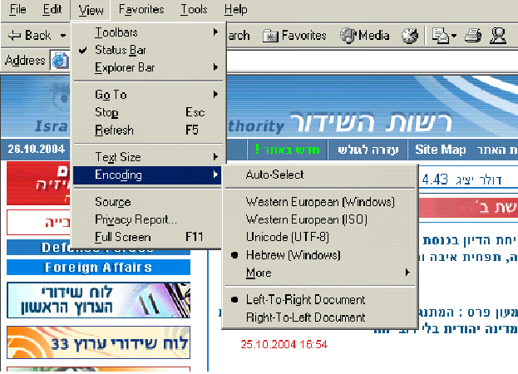
This window shows which character set the browser uses.

Slide 14
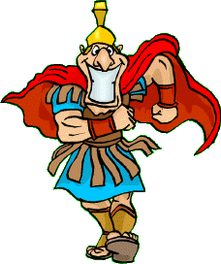
Eventually even 8-bit “international” ASCII did not do the job!
So Unicode, or UTF-8, was developed as an international character-encoding standard. It is backward compatible with ASCII and is a variable-width encoding system that can represent every character in the Unicode character set using one to four 8-bit bytes
For example, the letter Latin capital letter "A" has the value (or "character code") U+0041 in Unicode. A total of 65536 characters can be represented from all major languages of the world.

Slide 15
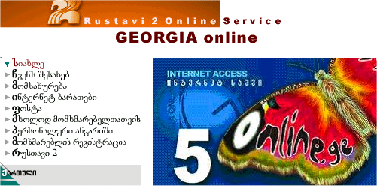
This webpage, for an ISP in the Georgian Republic, uses 16-bit Unicode for the script on the left.
However the browser must have an appropriate font installed to be able to display it correctly!

Slide 16
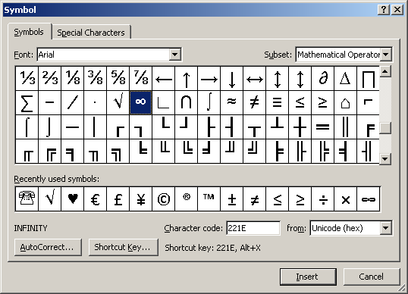
The characters in Word are based on Unicode – each letter requires 16 bits of storage. Here is the infinity symbol ∞.
By contrast, Notepad files are stored in 8-bit ASCII.

Slide 17
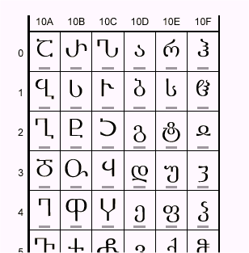


This shows part of the Unicode table for Georgian script. The character (shin), for example, has the Unicode value U+10E8. The hexadecimal number is called a code point and is always prefixed by a U.
This would be stored in binary as
0001 0000 1110 1000

Slide 18
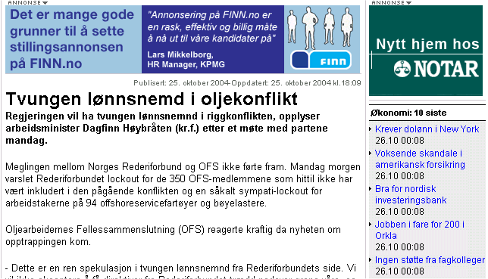
By contrast, the main body of text in this Norwegian page uses ISO 8859 subset 4.

Slide 19
A UTF (Unicode Transformation Format) is an algorithmic mapping from every Unicode code point to a unique byte sequence.
UTF- 8 – Since Unicode is relatively new and there are a great many programs still in use that only allow 8 bit character representation, this form was developed to provide backward compatibility.
UTF- 16 – This is the default encoding form and maps code points to either one or two 16 bit integers.
UTF- 32 – This is the most straightforward form as it maps each code point to just one 32 bit integer, but it is also the most expensive in terms of storage.

Slide 20

For your assessment questions, you will be shown some characters or symbols and asked to describe how they are stored in various formats.
Show how the punctuation character ] (right square bracket) could be stored using 7-bit ASCII.
010 1001
100 1001
101 1101
111 1101
Show how the Arabic letter peheh ڦ could be represented in Unicode.
U+06A6
U+06A8
U+06C6
Arabic can’t be stored in Unicode.
The seven-bit ASCII value 010 0111 represents
the apostrophe
the escape key
the full stop
the number 27

Slide 21

Any Questions?

Slide 22

Summary
Characters have to be converted to binary in order to be stored.
There are a number of different standards for the storage of text and symbols.
Basic ASCII allocates 7 bits per character and stores up to 127 different symbols. All the other standards are descended from 7-bit ASCII.
ISO-8859 is an 8-bit standard using the basic ASCII set with extra subsets.

Slide 23

Credits
EBCDIC Mainframes © IBM
WWII Teletype machines © Practical Electronics
Browser Page showing character sets © Israeli Broadcasting Authority
Georgia ISP page © Rustavi-2 Communications
Picture of Tiblisi © Georgia Ministry of Tourism
Norwegian news page © Norsk Telecomm
All other graphics © Focus Multimedia with open licence, unless stated
All other contents © Aberdeen College 2010

